Slide 1
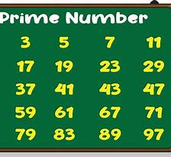
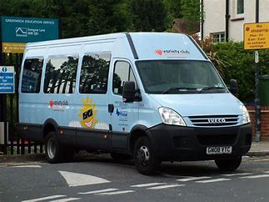
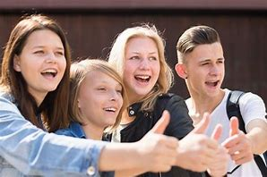
Post 16.1 – Autumn 2024
We will be exploring ASDAN Employability this year developing a range of skills.
In maths, this year, we will be doing AIM Functional Skills. This term we will be looking at number skills.
Students will begin thinking about work experience this term,
tailor-making placements, where possible, to students interests.
In English we are focusing on reading and writing this term and working towards AIM Functional Skills.
In Vocational studies this term, students will choose a subject they would like to complete from 7 choices. This will change termly and will follow ASDAN Life Skills Challenge.
We will be ‘Preparing for Adulthood’ and completing ASDAN Realising Aspirations.
We will be starting our trips out in the community on a Monday afternoon developing life skills, communication and social skills.
Our leisure slot will be Friday afternoons when we will explore fitness and sports as part of the Duke of Edinburgh Award and develop social skills.
We will continue completing various parts to make up our Duke of Edinburgh Award including *volunteering
*Skill
*Sport.
In PSHE this term students will begin following ASDAN Personal and Social Development.
Mrs Brookes 06/09/24

