Slide 1
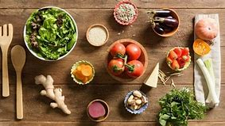
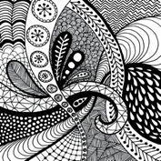
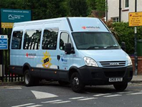
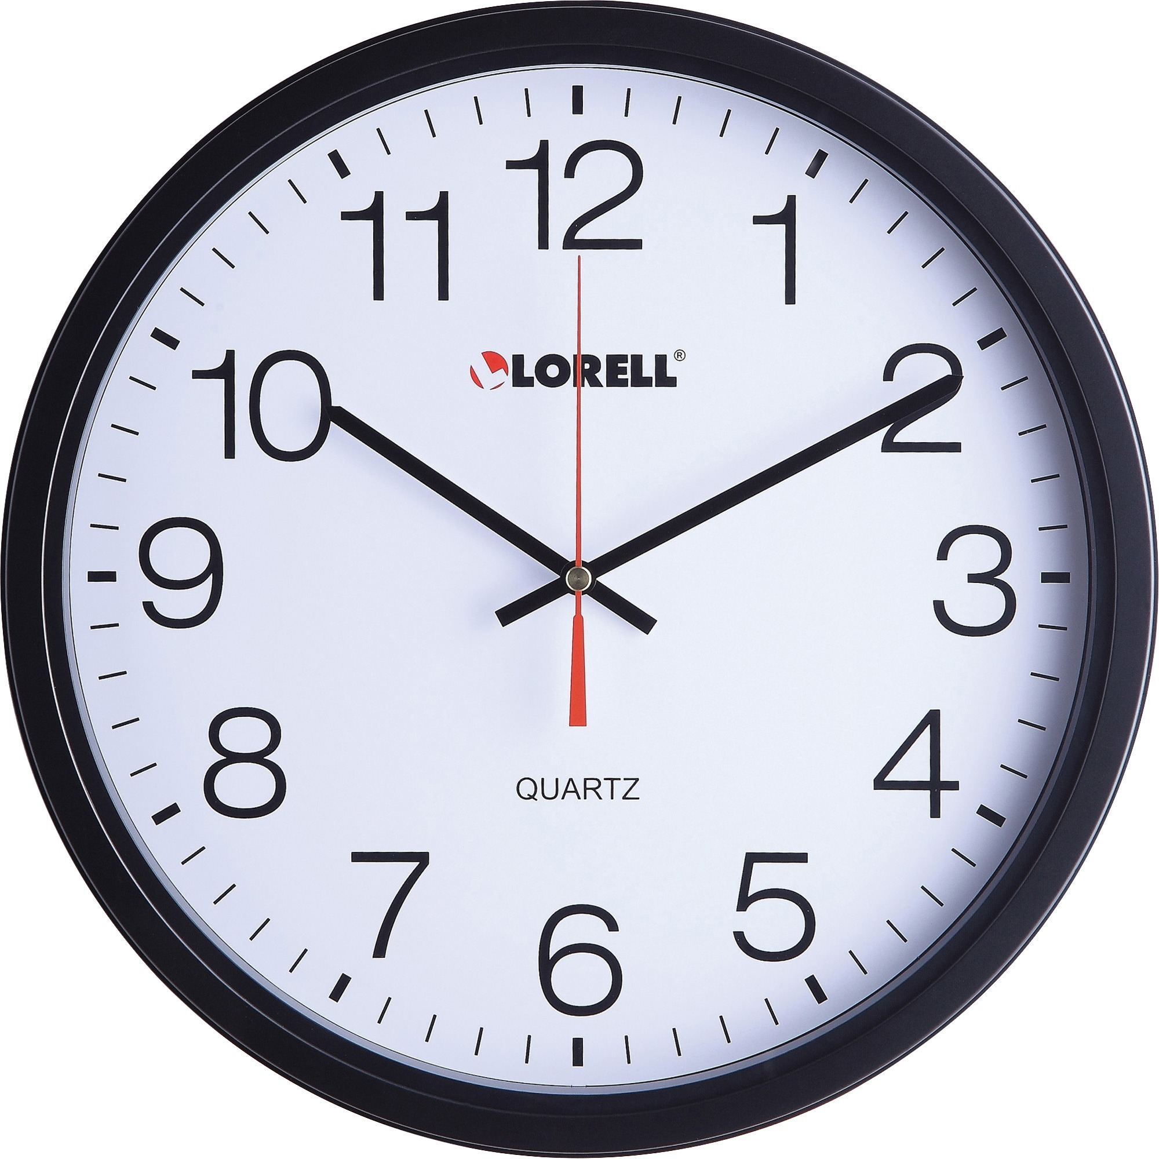
In art this term we will be exploring Zentangles and how they can be used to aid mindfulness. We will be having a go at creating our own designs.
In our world of work sessions we are completing a unit titled ‘Preparation for work; identifying skills and qualities and matching them to future job ideas.
This term for our vocational sessions, we will continue work to support the community as part of the DofE award and also explore basic food preparation.
Our leisure slot will continue to be Friday afternoons when we will explore fitness and sports as part of the Duke of Edinburgh Award and also as part of our healthy living unit.
In maths, this term, we will be looking at using time and money in real- life situations.
We will continue our trips out on a Wednesday afternoon developing life skills and independence and also supporting and reinforcing many OCR units of work.
In PSHE this term, students will be learning how they can live a healthy lifestyle and activities that could improve physical and mental health.
Also, this term in ICT we will be looking at how to produce text documents and text editing.
We will continue completing various parts to make up our Duke of Edinburgh Award including; *Volunteering
*Skill
*Sport
In English we will be continuing to develop our reading, writing and communication skills by using them in real-world situations.
Jackie Woods Post 16.1

